Slide 1
HDFC + 3LOQ

Slide 2
Agenda
Introduction to 3LOQ
Five 3LOQ Principles
Process
Results
Next Steps

Slide 3



3LOQ : About Us
An angel investor firm backed by a USD bn. Conglomerate, principal investors in 3LOQ Labs
3LOQ Founders have successfully launched ADAPTXT, a predictive text engine across all existing mobile OS. Currently embedded in LG and Fujitsu phones
Team with cutting edge experience in computer science, algorithms and marketing communications.
Young, innovative computer science and analytics team collaborating with experienced marketing communication professionals.

Slide 4
3LOQ: SIMPLE CONNECTIONS
Building Simple Connections with consumers by understanding their behavior Patterns

Slide 5
3LOQ: Core Principles
Underlying principle: Focus on the consumer
Inventory is unlimited
Consumers are finite
Individual fingerprinting of consumers allows for dynamic behavioral segmentation, connecting consumers to brands in the right context and finding potential new customers.
Works on patterns instead of signals to build a comprehensive predictive model of individual customers across billions of location and behavior data points.
Organic Segmentation and Contextual Marketing.
End-to-end automation of data pipeline.

Slide 6
3LOQ
Distributed Computing
Automated Data Pipeline
Isolated Components
Stand-alone deployment

Slide 7
3LOQ
=
Bank Multi-Channel Data
+
Text Mining
=
Proactive Consumer Selection
+
Direct Communication to Consumers
+
Effective Consumer Connections

Slide 8
3LOQ Targeting

Slide 9

1
3LOQ Targeting
Existing Solution
Everyone
Everyone
3LOQ
Marketing Cost
$
Cost of Irritation
--
EXISTING SOLUTION
Marketing Cost
$
Cost of Irritation
$

Slide 10
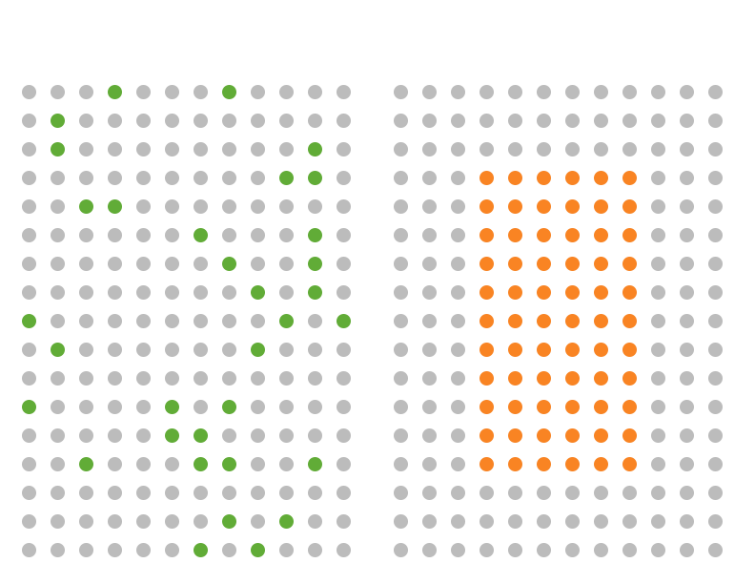
3LOQ Targeting
2
Existing Solution
Consumers handpicked by
ARJUNA based on Share of Intent
Consumers selected by demographic/psychographic targeting
3LOQ
Marketing Cost
$$
Cost of Irritation
--
EXISTING SOLUTION
Marketing Cost
$$
Cost of Irritation
$$

Slide 11
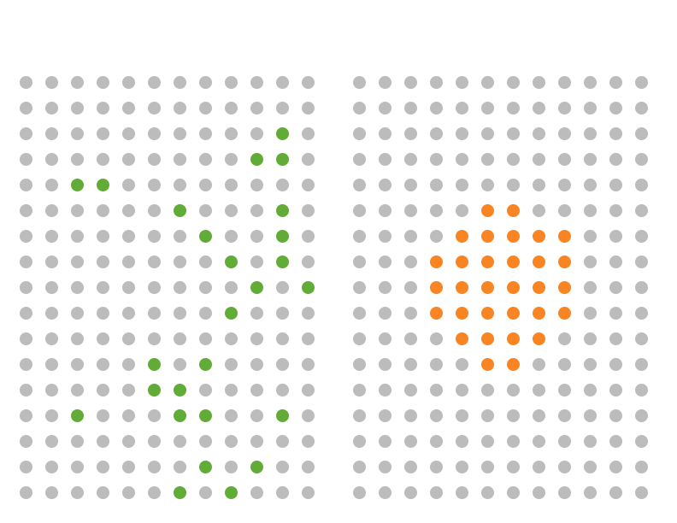
3
3LOQ Targeting
Existing Solution
Consumers interested
in your brand NOW
Consumers actually interested in
your brand and product
3LOQ
Marketing Cost
$$$
Cost of Irritation
--
EXISTING SOLUTION
Marketing Cost
$$$
Cost of Irritation
$$$

Slide 12


4
3LOQ Targeting
Existing Solution
Consumers interested
in your brand/product NOW
3LOQ
No 4th Step.
Less cost.
Happy Brand.
Happy Customers.
Marketing Cost
$$$
Cost of Irritation
---
EXISTING SOLUTION
Marketing Cost
$$$$
Cost of Irritation
$$$$

Slide 13
3LOQ advantage: The Three Multipliers
S.O.I
share of intent
C.O.C.
cost of conversion
C.O.C.I.
cost of consumer irritation

Slide 14
3LOQ Product DEmo @ HDFC

Slide 15
Problem Statement
Problem Statement: Understand the underlying factors that help predict a customer’s purchase propensity in next quarter for particular products
POC Duration: 3 weeks
Constraints: Due to hardware limitation, model was built only for Credit Card product and individual salaried customers (1,53,666)
Notes:
We will start out by defining the problem we set out to solve. Essentially, since Finance was a new vertical we are tagetting, we first wanted to understand the factors that determine consumer behavior and propensity to a particular product. We collabrated closely with the HDFC analytics team to form an undersatning of the transaction data.
Due to limited access to hardware and time, we limited the scope.

Slide 16
HDFC Data Summary
Cities: Jaipur, Hyderabad
Time Window: 12 Months (2013 Aug - 2014 July)
Data Set:
CASA Source Transactions
Fact transactions
Product Holding
Customer Base Analyzed: Model was built for individual salaried customers (1,53,666)
Notes:
We used both fianacial and non-financial transactions
Financial transactions were primiarly drawn from CASA Source Transactions
Non-financial transactions used were primairly requests made to HDFC for a vairety of services such as cheque books and statemsns via IB, MB, Etc
Basis the “salary” transactions, we identified salaried individuals. We choose this as this was the single largest set of individuals.
3. Outcome: background of the dataset used so as to give the context to evauate the results

Slide 17
3LOQ Recommendation Model Creation
Text Mining
Product Holdings
Financial Behavior
(Fact Table)
Engagement with HDFC
(Source Table)
3LOQ Recommendation Model
Notes:
Financial behavior:
Text Mining:
Product holdings
Engagement with HDFC
In the next slide we will do a deep dive into how the model is created

Slide 18
Challenges & Process
Data Analysis
Transaction Mnemonic Categorization
Feature Selection
Model Building
Results Validation
Ranking against Population
94 different features were captured from the categorized transactions
More that 350 transaction mnemonics were analyzed and categorized using text mining techniques
Two sets of 18 features and 6 features selected from 94 using random forests, an ensemble learning technique.
Notes:
Outcome: What & Why
What: Understand Mnemonics, Why: understand where the customer spends his money, categorize his spending
What: Dissect transaction, How:
We started out by understanding the mnemonics present in financial transactions, their distribution and what they mean in context of the customer. The primary reason for doing this was to understand how the customer spent his money
mode (cash, cheq, etc),
channel preferences (IB, MB, branch, ATM)
Destination of the funds (counter-party): WHERE and HOW was the customer allocating his funds.: our hypothesis was that correctly identifying and categorization the destination of the funds would be most critical in characterizing the customers intensions and needs
Associated financial products (loan installments, term deposits, MF & shares,
There were more than 2500 mnemonics, out of which around 350 accounted for 98% of the transactions.
Analyzing behavior across 350 different types of transactions would be intractable hence we wanted to categorize and group the mnemonics so that the spending behavior could be characterized accurately while being computationally feasible.
We grouped the debit tx into 4 broad categories: Installments, Investments, General Spends (shopping, merchants, POS, etc), Unknown
We then used basic text mining techniques to find the most popular keywords in the transaction descriptions as this would help us categorize where a customer spends their money
We then created features based on various attributes based frequency, variety, intensity, monetary amount of the transactions.
As the number of potential features/inputs were quite large, we applied the algorithm of Random Forests to help discover features that have the more predictive power specifically for predicting intent to opt for a credit card.
For each feature, we then create an index such that we rank every customer in the base against everyone else. Rather than working on absolute numerical values, the index gives relative rank for a customer, making the features adaptive.
We used ARM to develop the primary predict model. The primary advantage of ARM is that it is able to discover unique as well as general relationships. ARM has the ability to find non-linear relationships between entities at the same time is computationally efficient such that it can be run on the entire population.
Parameter tuning of ARM is done basis the data
What is unique: Distributed platform + Automatic parameter tuning + advanced feature creation and selection
Results validation

Slide 19
Text Mining
Process:
1. Got the most popular keywords from all the transaction description of the active users
2. We matched it with the transaction description and categorized whether it was a spending, another bank transaction, SME customer, etc.
Example:
SME: whether a customer is an SME or not
Vehicle: whether a customer owns a vehicle
Loan: loan with HDFC or another bank
Other Bank: transactions with 'ICICIBANK’, ‘SBI’, and other top 50 banks operating in India
Merchant: 'IRCTC’, Flipkart, Snapdeal, etc

Slide 20
results

Slide 21
Base for Creation of Recommendation Model
Base: Total Population having salaried account within Hyderabad/Jaipur active in between Aug, 2013 to July, 2014. Only those people were considered who bought Credit Card after April, 2014.
Target Product: Credit Card
Train Set: 40% of Base: Model was built on customers in this set.
Test Set: 40% of Base: Predictions were made for customers in this set.
We divided the time period into 2 time windows: Model Input, Prediction
Model Input Window |  |  | Prediction Window
T1: Aug – Oct 2013 | T2: Nov – Jan 2014 | T3: Feb – Apr 2014 | T4: May – Jul 2014
BAU in T4: (Actually got product in T4 but did not have until T3)/Base Population: 1.17 %
Base Population | Actually Got Product in T4 but did not have in T3
153542 | 1803
Notes:
Base:
The base population was selected as it represents that largest segment of consumers
The base was divided into train/test sets. The validation set was left unused due to the lack of time.
To simulate a lives test environment, we split time into 2 windows:
Model Input window: Calculate the features
Model Input Window: for the train set, the transactions in this time period were used to create the model. In the test set, the transactions in this time period were used as model input for prediction.
Prediction: for the test set, we used this time period to check whether the customer got the product.
The reasoning for splitting into two windows is:
Capture transaction pattern before the customer intends to purchase a particular product
Use captured patterns to predict future behavior of customers

Slide 22
Formula for evaluating the Recommendation Model
Rules: Pattern or fingerprint which is used to select the user for a given a product.
Recommended: Number of people selected from the Test Set who had affinity to purchase the product in prediction window (T4). This was done to simulate performance in live test environment.
Conversion: Conversion rate of the rule i.e how many it recommended and of those how many actually bought in the prediction window T4
LIFT: Total Conversion/BAU
Rule | Recommended | Conversion | Lift
Salary: Medium | Income trend: increasing | Q3 spending: high | 3626 | 3.2% | 2.7

Slide 23
3LOQ Rules – Anatomy
Level compared to the rest of the population.
High: top 33.3%
Med: middle 33.3%
Low: bottom 33.3%
Time Window of Feature
t3 credit_amt med
Feature: amount credited
Multiple variables are combined to form a 3LOQ Rule
t3_credit_amt_med | t3_t2_credit_ratio_inc | t3_spending_cnt_high

Slide 24
3LOQ Rules – Contextual Marketing
Triggers for contextual marketing comes from combination of different variables.
Few examples:
3LOQ Rule : t3_credit_amt_med| t3_premat_flag_yes| vehicle_flag_yes
Explanation: In Q3, Income is medium (compared to the population),
and the user has a premature withdrawal of TD
and the user owns a vehicle. So recommend him a credit card.
2. 3LOQ Rule : high_salary| forexFlag_yes| t3_spending_income_ratio_high
Explanation: Salary of user is high and user has a Forex transaction and the users
Spending to income ratio is high. So recommend him a credit card.
3. 3LOQ Rule : t3_credit_amt_med| t3_t2_credit_ratio_inc| t3_spending_cnt_high
Explanation: In Q3, total amount credited to a user’s account is medium (middle 33%)
and the Income shows an increasing trend from Q2 to Q3 and the number of
Spending transactions of user is high in Q3. So recommend him a credit card.

Slide 25
Recommendation Models
Coverage: The size of the campaign audience. We can use one or more of the models based on business and campaign requirements.
Multiple models: We created multiple models that tradeoff between having a wider campaign audience or higher lift.
>Recommendation model 1 was created to have a selective coverage and high lift.
>Recommendation model 2 was created to have a medium coverage and medium lift.
>Recommendation model 3 was created to have a wider coverage and decent lift.

Slide 26
Recommendation Model 1: Selective Coverage and High Lift
Rules | Recommended | Conversion | Lift
med_salary| q3_credit_amt_med| q3_engagement_high| q3_q2_credit_ratio_inc| q3_spending_cnt_high| q3_spedning_income_ratio_low| | 152 | 5.5% | 4.7%
med_salary| q3_credit_amt_med| q3_engagement_med| q3_q2_credit_ratio_inc| q3_spending_cnt_med| q3_spedning_income_ratio_low| | 105 | 5.0% | 4.3%
q3_credit_amt_med| q3_engagement_high| q3_q2_credit_ratio_inc| q3_spending_cnt_high| q3_spedning_income_ratio_low| | 91 | 4.6% | 3.9%
med_salary| q3_credit_amt_high| q3_engagement_low| q3_q2_credit_ratio_inc| q3_spending_cnt_high| q3_spedning_income_ratio_low| | 206 | 4.5% | 3.8%
high_salary| q3_credit_amt_med| q3_engagement_med| q3_q2_credit_ratio_inc| q3_spending_cnt_high| q3_spedning_income_ratio_med| | 139 | 4.5% | 3.8%
high_salary| q3_credit_amt_med| q3_engagement_med| q3_spending_cnt_high| q3_spedning_income_ratio_med| | 182 | 3.9% | 3.3%
Total Coverage: 875
Overall Conversion: 4.6%
Overall Lift: 3.9%

Slide 27
Recommendation Model 2: Medium coverage and Medium lift
Rules | Recommended | Conversion | Lift
med_salary| t3_t2_credit_ratio_inc| q3_spending_cnt_high | 3626 | 3.2% | 2.7%
med_salary| t3_t2_credit_ratio_inc| vehicle_flag_yes | 843 | 3.0% | 2.5%
med_salary| vehicle_flag_yes| t3_spending_cnt_high | 1412 | 2.8% | 2.3%
Total Coverage: 5881
Overall Conversion: 3.1%
Overall Lift: 2.6%

Slide 28
Recommendation Model 3: Wide coverage and Decent lift
Rules | Recommended | Conversion | Lift
t3_credit_amt_med| t3_premat_flag_yes| vehicle_flag_yes| | 679 | 3.5% | 2.9%
t3_credit_amt_med| t3_t2_credit_ratio_inc| t3_spending_cnt_high| | 2856 | 2.9% | 2.5%
med_salary| t3_t2_credit_ratio_inc| vehicle_flag_yes| | 1412 | 2.9% | 2.5%
med_salary| vehicle_flag_yes| t3_spending_cnt_high| | 1260 | 2.5% | 2.1%
t3_credit_amt_med| vehicle_flag_yes| otherBank_yes| | 956 | 2.5% | 2.0%
Total Coverage: 7163
Overall Conversion: 2.8%
Overall Lift: 2.4%

Slide 29
3LOQ – Potential Next steps

Slide 30
Potential Next Steps
Extensive analysis of transaction mnemonics that will provide a deeper understanding of where customers spend their money, what merchants they interact with and how they transact with other banks
Collaborate with HDFC marketing team to develop triggers that directly incorporate contextual messaging
Determine best time to engage with customer based on transaction behavior

Slide 31
Engagement details: deployment & pricing

Slide 32

3LOQ Product Recommendation - Advantage
HDFC
Current Process
Recommendation
Generate leads
$$
Analysis
Analyze results
$$$
Licensed
Result
Apply Model
$$$
Licensed
Model
Create Score Card
$$$
Licensed
Platform
Data Warehouse
$$$$$
$$
Total

Slide 33
Deployment Requirements
Algorithm requires high performance computing environment to process the data
Hardware Requirements: A cluster of 8 to 10 nodes.
Node configuration: 4-8 core CPU, 32GB RAM and 1TB disk space.
Time required to install: Setting up the entire system should take 2-3 hours.
Notes:
Single node configuration: 8 core CPU, 32GB RAM and 1TB hard drive.

Slide 34
Pricing Model – 3LOQ Product Recommendation
Paid POC : Rs 6 L/month
Large-scale deployment of recommendation engines requires significant amounts of resources for development and operations.
To demonstrate our commitment to this project we propose a Build Operate Transfer (BOT) model wherein we would build and operate the recommendation system for a period of 3 to 6 months (BOT period), constantly improving the system by allocating dedicated resources (FTE) for this project.
Commercial Model :1.2 Cr/year
Commercial mode share between CAPEX and OPEX:
CAPEX: 3LOQ Hardware and Software. Rs 84 L
OPEX: 3LOQ Recurring administrative and Consulting expenses. Rs 36L (Rs 3L per month)

Slide 35
Summary

Slide 36
Summary
3LOQ provides product level recommendations for users to decrease their acquisition cost and increase engagement with the bank
3LOQ find patterns in transaction history of users to determine the context and recommend appropriate products tailored to their need
Given an opportunity, 3LOQ will like to deploy 3LOQ in collaboration with HDFC to work on the immense business opportunity

Slide 37
Thank You

